Slide 1
Double Pendulum Control by Reinforcement Learning
Group H: Cem Alptürk, Pukashawar Pannu
2021-04-22

Slide 2
Agenda
Project Description
Problem definition
Ideas on how to solve the problem with reinforcement learning
Implementation so far
Code structure for simplifying solving similar problems
Demos
Single pendulum untrained
Single pendulum problem (solved)
Double pendulum untrained

Slide 3

Project Description
Goal: Control inverted double pendulum on cart.
Chaotic problem
Requires small time steps
Learn from experience

Slide 4
Problem Solution Ideas
Reinforcement Learning
Q-Learning (implemented).
Double Q-Learning (looking into).
Model based learning (looking into).
Training in steps
Train in small domain and then expand into larger domain.
Main focuses:
Rewards
Termination conditions

Slide 5
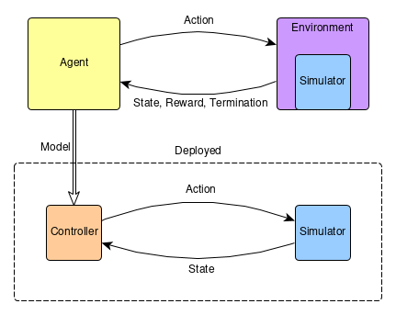
Implementation so far
Agent -> Environment -> Mechanical Problem
Agent produces a controller that can be used when simulating mechanical problem
Agent is independent of the problem (can be reused)
Balance single inverted pendulum on cart
Balance double inverted pendulum on cart

Slide 6
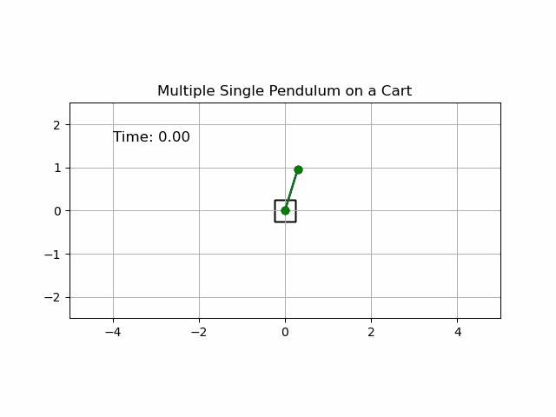
Uncontrolled Pendulum

Slide 7
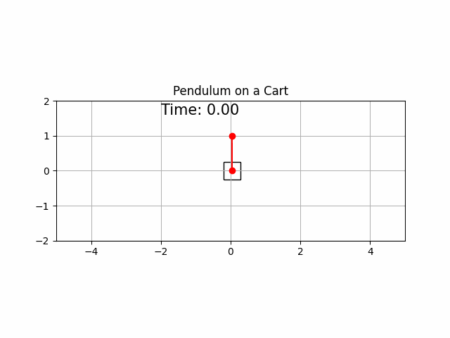
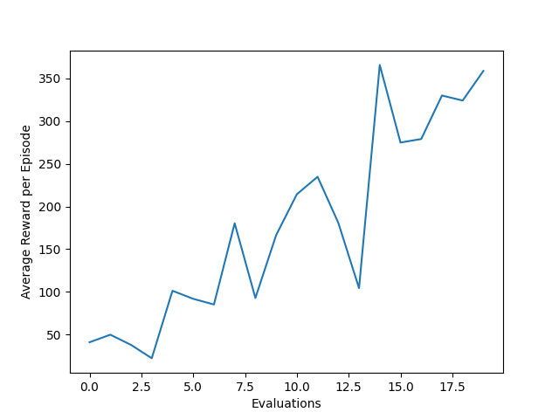
Controlled Pendulum
Much easier to control
Faster convergence

Slide 8
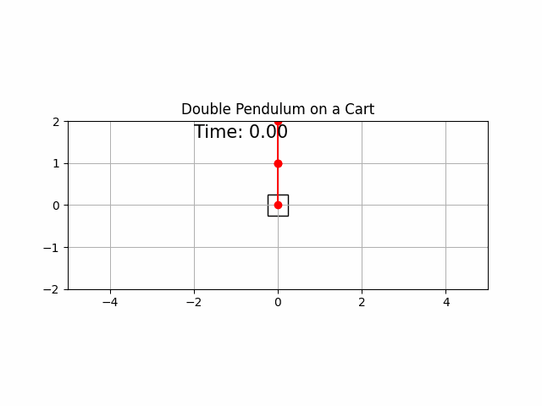
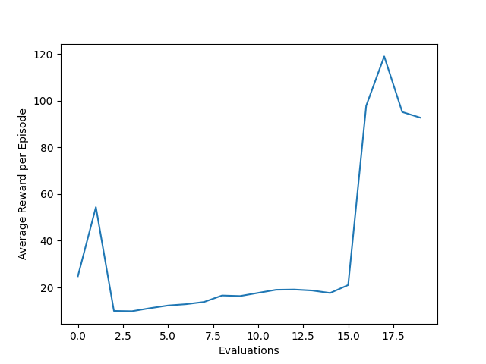
Double Pendulum
Our results so far

